Slide 1

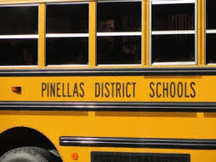

_{https://www.pcsb.org/Page/837}
CLASS of 2028
Discover Your Future: Choice Application 2019

Slide 2







PCS offers nearly 80 programs focused on students interests, talents and learning styles.
The Application Period for the 2023-2024 school year is:
The Acceptance period for the 2023-2024 school year is Feb.14 - 23,2024
Jan. 9-19, 2024

Slide 3

IB Program
Need to be in Algebra I Honors or higher a level Math to apply
Where: Palm Harbor University HS
St. Petersburg HS
Largo HS
What:
The IB Program offers 2-years of rigorous IB Diploma curriculum in 11th and 12th grades.
During 9th and 10th grade, students will be offered a challenging pre-diploma program.
Recognized by top universities around the world!
Six Areas of Study:
Language
Second Language
Individuals & Societies
Experimental Sciences
Mathematics
The Arts
Focuses On:
    Creativity
    Action
    Service
About IB World Wide
https://www.pcsb.org/domain/2908
https://www.pcsb.org/domain/2908

Slide 4

Cambridge Advanced International Certificate of Education (AICE)
Earn Bright Future Scholarship
Where:
Tarpon Springs HS, Clearwater HS, Countryside HS, & Hollins HS
Cambridge-AICE is an international diploma that allows students to earn college credits while learning through a challenging and advanced curriculum.
Pre-AICE curriculum is offered during 9th and 10th grade AICE curriculum is offered during 10th, 11th, and 12th grade.
Developed by Cambridge University to prepare students for post-secondary education!
Clearwater HS:
https://www.pcsb.org/domain/2750
Hollins HS:
https://www.pcsb.org/site/Default.aspx?PageID=8396

Slide 5


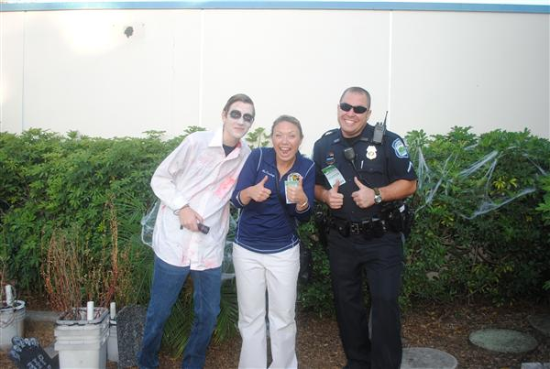
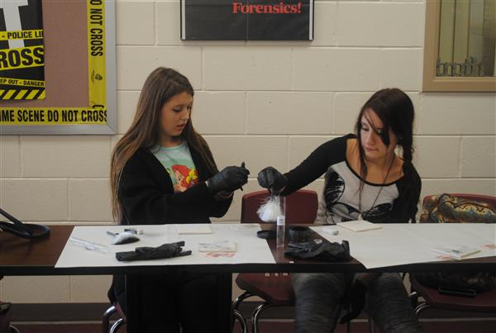
Criminal Justice Academy
Where: Pinellas Park HS
What:
4-year program
Designed for students interested in law, law enforcement, or criminal-justice related careers
Students will learn about forensic science, law investigations, and court and police procedures
Criminal Justice Academy Video
Video of CJA
https://www.pcsb.org/domain/2746

Slide 6

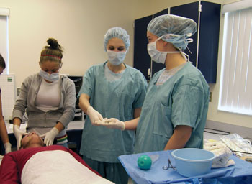
Center for Wellness and Medical Professions
Where: Palm Harbor University HS
Boca Ciega HS
What:
Prepares students to work in the medical field
Students develop a commitment to personal wellness and disease prevention
Prepares students to pursue postsecondary education or to enter an entry level medical or wellness position
Palm Harbor:
https://www.pcsb.org/Page/34826
Boca Ciega: https://www.pcsb.org/domain/1225

Slide 7

Exploring Careers & Education in Leadership (ExCEL)
Where: Largo High
What:
Student-centered learning environment
Prepares students for colleges and careers
Hands-on learning and activities in additional to traditional teaching
Focuses on career exploration through shadowing
Based on the AVID philosophy
Focuses on building strong leaders through real world experiences
Areas of Study:
Leadership
Career Development
Internships
Interdisciplinary Class Project
https://www.pcsb.org/domain/3314

Slide 8

Business Economics Technology Academy (BETA)
Curriculum highlights: business, technology, and economic concepts, industry competencies and certifications, and marketplace trends with traditional core classes.
Where: Gibbs HS
https://www.pcsb.org/domain/2548
What:
Curriculum focused around business and technology systems
Prepares students for immediate job placement or college entrance after graduation
Provides job shadowing and internship opportunities
BETA
Pathways:
Digital Video Technology
Business and Entrepreneurial Pathway
Computer Science Pathway
Game and Simulation Pathway

Slide 9
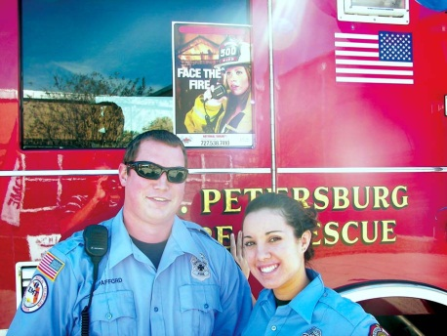

First Responders: National Guard Center for Emergency Management
https://www.pcsb.org/domain/2747
Potential Courses:
Emergency Planning
Safety, First Aid, & CPR
Basic Fire Fighting Concepts
Community Based Organizations
National Response Plan & National Incident Management System for Homeland Security
Where: Pinellas Park HS
What:
Focus on service to community through a variety of careers in emergency management, planning and response.
Students will acquire leadership and team-building skills through project-based learning, mock disaster drills, disaster preparedness training and other hands-on experiences with state-of-the-art equipment.
Students can earn an industry certification in Firefighting and Emergency Medical Responder
Disaster Day 2019
Potential Careers:
Paramedic
EMT
Social Worker
Dispatcher
Air Traffic Controller
Fire Fighter
Security Guard
Health Educator
Disaster Day Video!

Slide 10
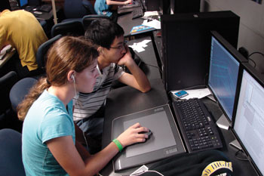
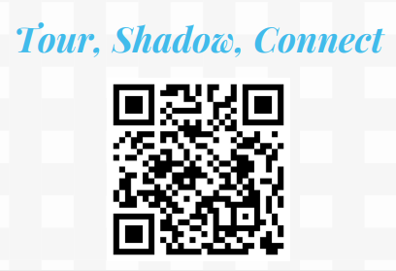
Center for Advanced Technologies (CAT)
Lakewood High School
Founded in 1990, the Center for Advanced Technologies, or CAT, is one of the most well-known mathematics, science, and computer education magnet programs in Pinellas County.
Choose from 3 different Pathways:
- Robotics
- Artificial Intelligence
- Content Creation
https://www.pcsb.org/domain/2600
CAT Video

Slide 11

Institute for Science, Technology, Engineering, & Mathematics (ISTEM)
Points of Interest:
Local, state, regional, & international science fairs participation
Hands-on curriculum
Focus on research
State-of-the-art equipment
Real world experience
Where: Countryside HS
Designed for students with strong skills and interest in STEM fields
Includes 3 strands of focus (grades 10-12):
Biotechnology
Computer Applications/IT Network Security
Multimedia/Television Production
Offered certifications: Microsoft Office Specialist, Adobe Suite, Apple FinalCut Pro, Biotechnology, & CompTIA Network+

Slide 12




Fundamental Programs
Where: Osceola, Boca Ciega, Dunedin
What:
Mandatory monthly parent meetings
Regular communication with teachers
Homework heavy curriculum
Demerit system
Stricter dress code enforced
Higher expectations for student behavior and cooperation
You know fundamental

Slide 13
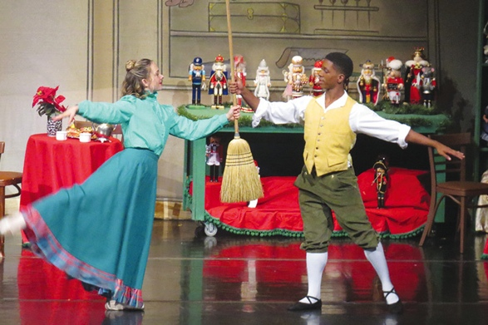

Pinellas County Center for the Arts (PCCA)
Program Tracks:
Dance
Design Technology
Visual Arts
Music
(Instrumental & Vocal)
Theatre Arts
(Performance & Musical)
Gibbs High School
Fulfill your academic requirements while
concentrating a specific art field
Designed as a college prep program
Prepares students for a career in their selected art field
Auditions are necessary before accepted into the program
Provides students with scholarship opportunities for post-secondary education
https://www.youtube.com/watch?v=tqqXiz6l9Aw
Gibbs HS Video

Slide 14
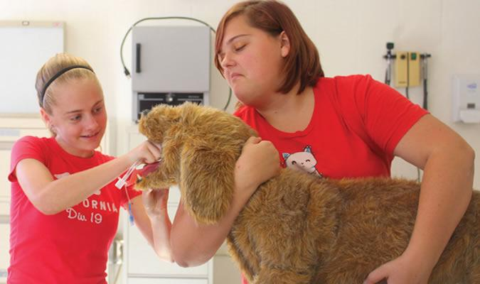
Richard O. Jacobson Technical High School of Seminole
Career Programs:
Building Construction Technology
Commercial & Digital Arts
Electricity
Game and Simulation Programming
Marine Mechanics
Nursing
Veterinary Assistant
*Formerly the Career Academies of Seminole
About Tech High
Students at Tech High participate in hands-on activities and collaborate on meaningful projects that train them to be critical thinkers and problem solvers. Students have the opportunity to take advanced-level classes, earn industry certifications, participate in internships and take advantage of college dual enrolment.
https://www.pcsb.org/techhigh
Video of CAS

Slide 15
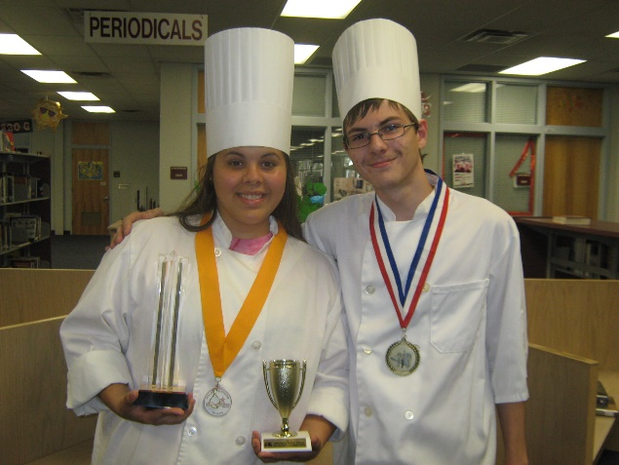
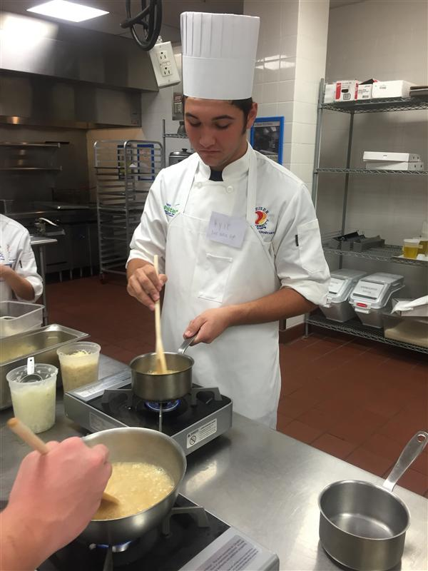
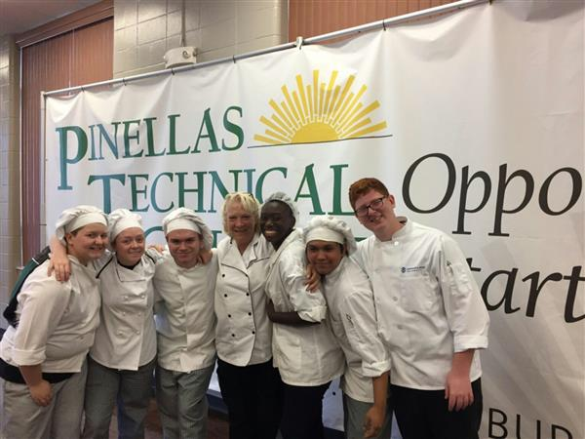
Center for Culinary Arts
Where: Hollins HS
What:
4 years of training in the fields of culinary trade
Hands-on experience learning how to prepare dishes
Students will be prepared for career in food service and hospitality
May earn up to three industry certifications
https://www.pcsb.org/domain/2479

Slide 16


https://www.pcsb.org/domain/2480
The Academy of Entertainment Arts
AEA is the fusion of an arts and technology program
Hollins
High
School
Programs:
Film
Game Design
Animation
Music Production
Photography & Image Design
Branding & Entrepreneurship

Slide 17

Clearwater High
Career Academy for International Culture and Commerce
Countryside
Center for Computer Technologies
Hollins
Academy of Entertainment Arts
Dunedin
Academy of Architectural Design and Building Technologies
East Lake
Academy of Engineering
Gibbs
Automation Production
Lakewood
Academy for Aquatic Management Systems & Environmental Technology
Journalism
Career Academies
List of Career Academi with Websites

Slide 18
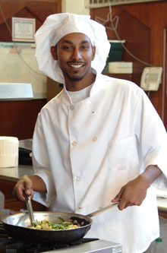
Career Academies (cont.)
Northeast
Center for Culinary Arts
Academy of Finance
Academy of Information Technology
Automotive Academy
Seminole
Center for Education and Leadership
St Petersburg
Center for Construction Technologies
Hospitality & Tourism
Junior Achievement 3DE
Tarpon Springs
Jacobson Culinary Arts Academy
Veterinary Science Academy
You have so many choices and opportunities! Take advantage and explore them!!

Slide 19

Mini-Magnet Fair
When: Tuesday, October 10th
*Great way to hear about the programs directly from the high school and ask questions
5:30 in our gymnasium at MBFS

Slide 20


Shadowing/Tours/Discovery Nights etc.
All programs run tours, shadowing and Discovery Night differently. Click below to keep up-to-date with the information we have or go to the different high school websites. See your counselor for more information, too!
https://new.express.adobe.com/webpage/CfQFSjINwML6p

Slide 21
Test Date:
October 11!
PSAT Testing
Why is it important?
High school District Application Process entrance criteria
Progression SAT assessments
Personalized student information and assistance
Tutoring

Slide 22

Any
Questions?

